Slide 1
lab: building water irrigation system that collects data using IOT
presented by :
Aboud Rayane

Slide 2
Introduction
In this lab we are going to be building an irrigation system that will collect data from environment visualizate it in real time and send it to google sheet in order to use it in future projects.. All that using iot materials such as arduino wmos d1…

Slide 3
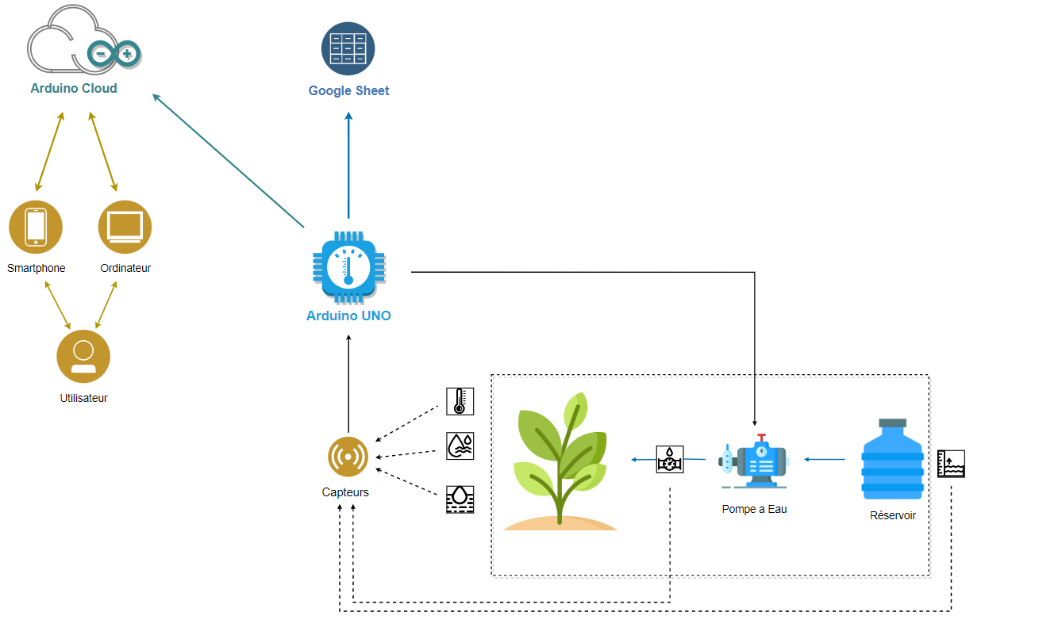

Slide 4
Material used

Slide 5
Controller:
The controller is the brain that will orchestrate the other parts of the system
It has three main functionality :
Collecting specific data from the environment
Controlling specific components of the system based on data collected
Sending this data to google sheets
[visualizing the data collection (this is an arduino cloud feature)]

Slide 6
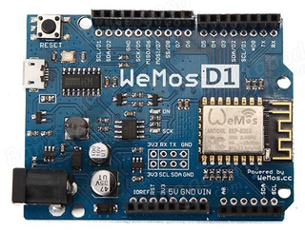
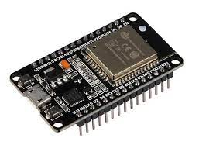
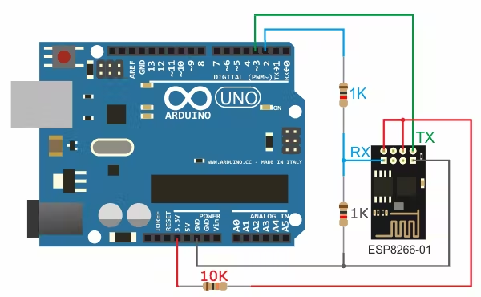
controller:
In our case our controller will be any type of arduino that can connect to internet using wifi (we can use wifi modules and plug it to arduino uno) in this lab we are going to be using Arduino wmos d1 which has esp8266
arduino uno + wifi module
arduino wmos d1
arduino esp32

Slide 7
Data collection from environment

Slide 8
Sensors:
Sensors are the intermediate part between our system and the environment, their main function is to translate a natural phenomenon into signal that our arduino can understand

Slide 9
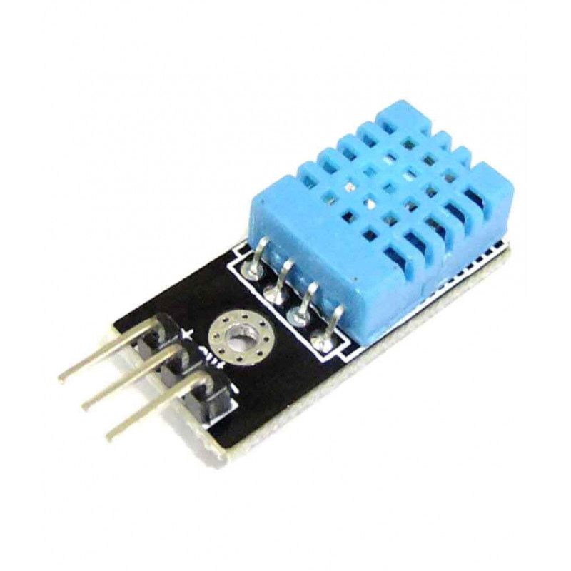
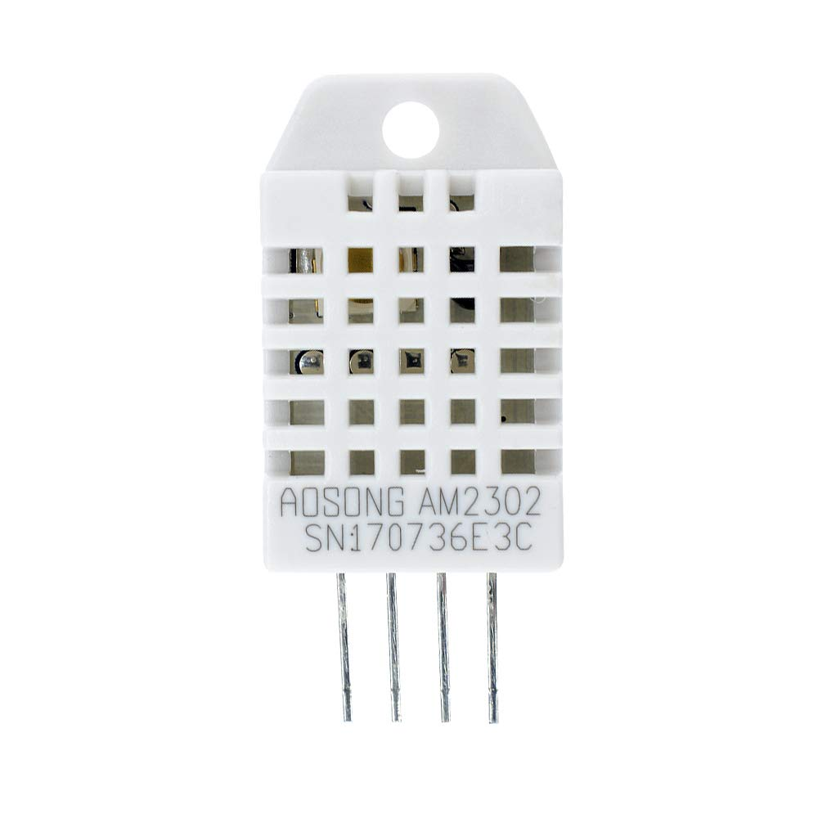
Sensors
Temperature and humidity sensor : in order to detect the temperature and humidity from the environment , in this lab we will be using DHT11
DHT11
DHT22

Slide 10
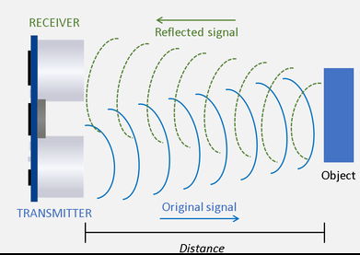
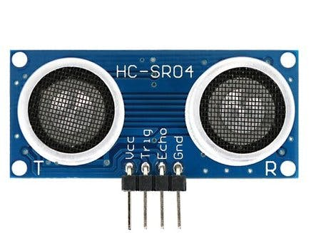
Sensors
ultrasonic sensor : for this we will be using this component in order to detect the water level in the reservoir, (we could also use water level sensor)

Slide 11
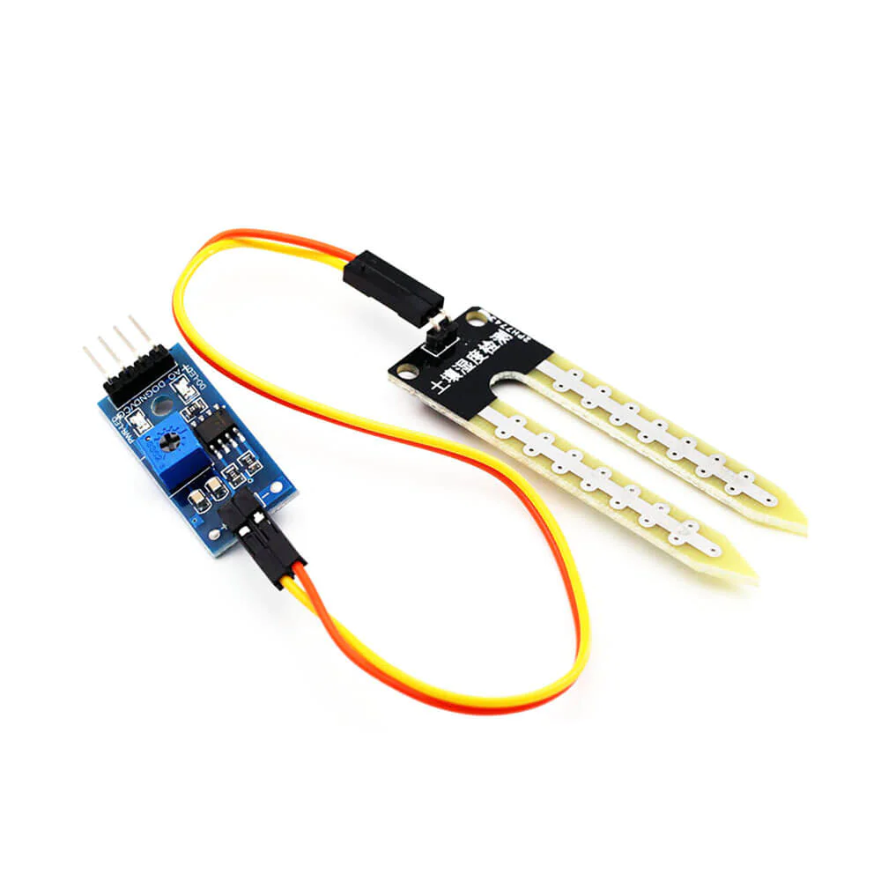
Sensors
soil moisture sensor : its role is to detect the degree of moisture in the ground

Slide 12
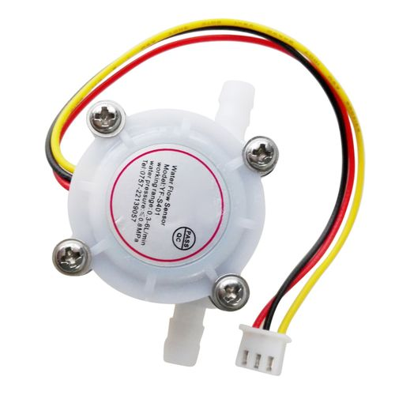
Sensors
flow meter (optional): detects the amount of water that flows through it

Slide 13
Component control

Slide 14
Controllable components:
those are the components that will be controlled (activated or deactivated) by the controller (Arduino) based on conditions that are related to informations that are collected by the sensors

Slide 15
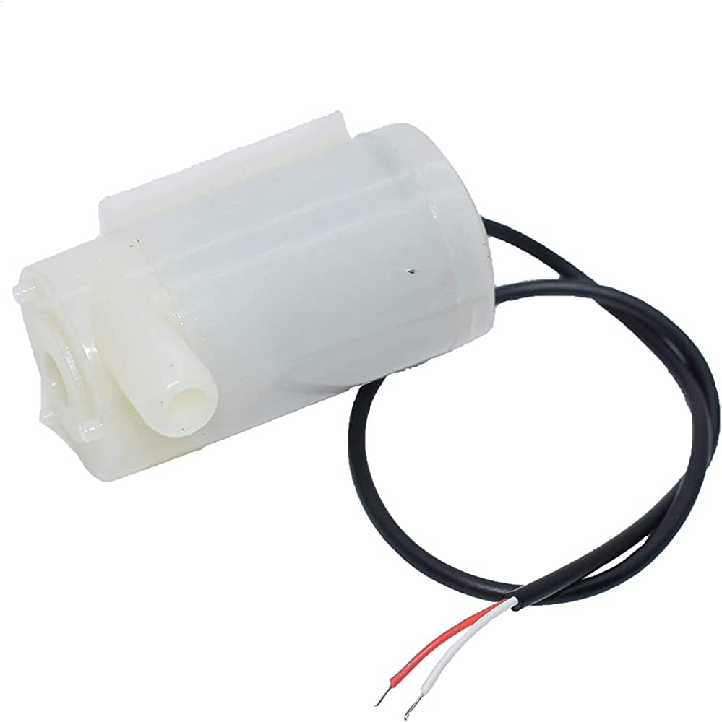
Controllable components:
water pump : the role of this component is to get water from reservoir and release it in appropriate target

Slide 16
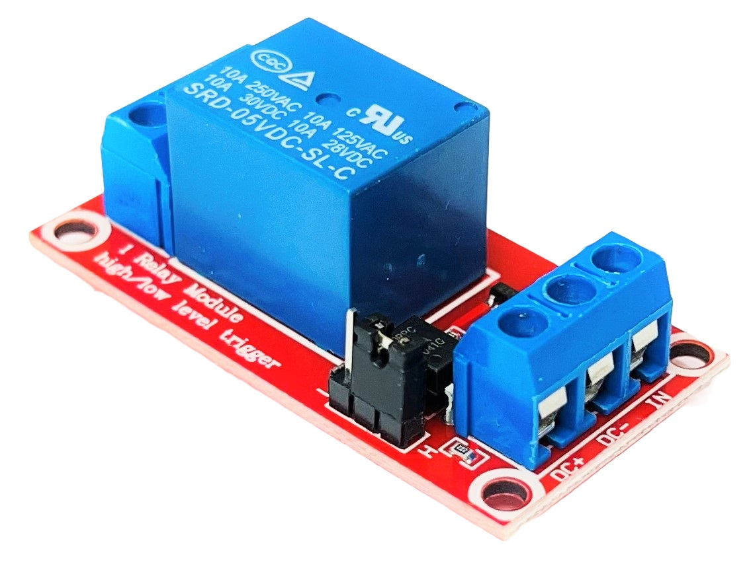
Controllable components:
relay : a device that will be used to help the arduino control the motor (will be explained in details later..)

Slide 17
Sending Data to google sheet

Slide 18
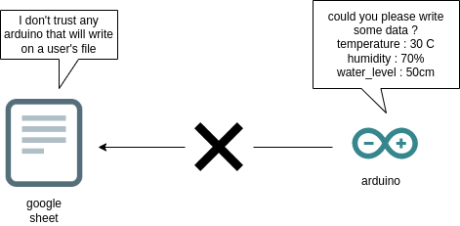
Problem
Since using google sheet requires authentication and security stuff, our arduino cannot send data directly to the sheet file

Slide 19
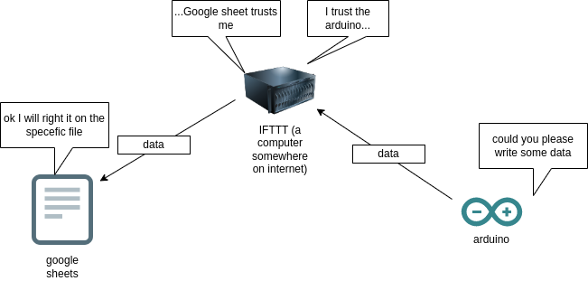
Solution
ifttt : a web service that will play the role of an intermediate computer (that google trusts) so that it will be allowed to write data on the file (it will be used in real time visualization)

Slide 20
Visualization of data in real time

Slide 21
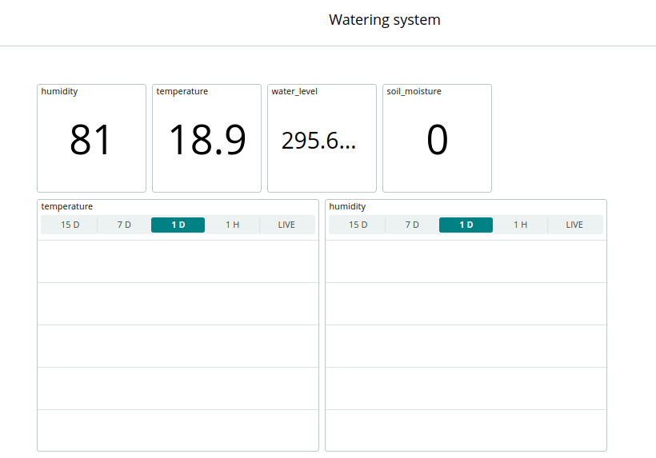
Arduino iot cloud
Web and mobile application that will allow us to visualize all changes in our system (In a user friendly way)

Slide 22
Assembly of the circuit components

Slide 23
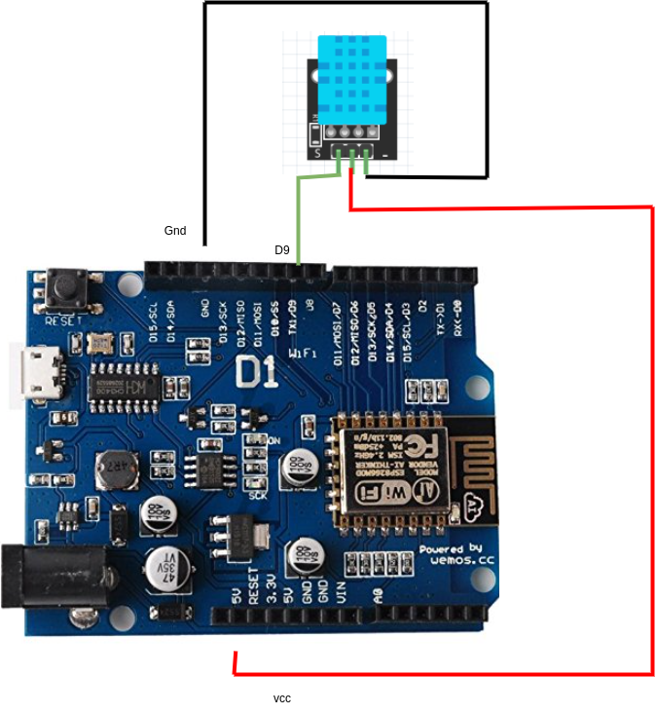
DHT11

Slide 24
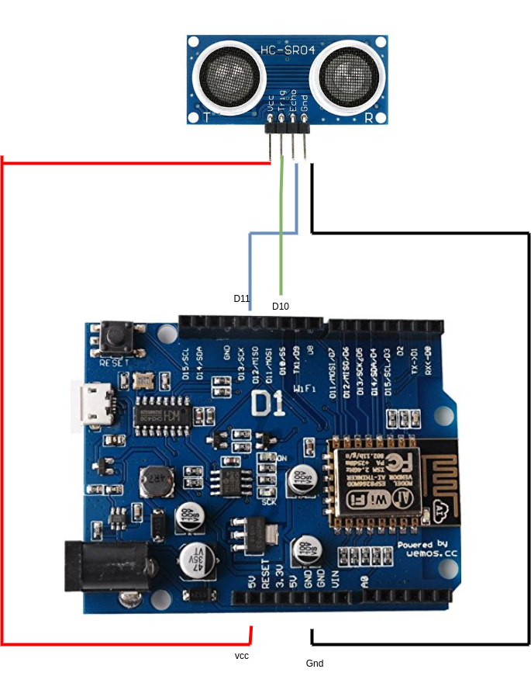
Ultrasonic sensor

Slide 25
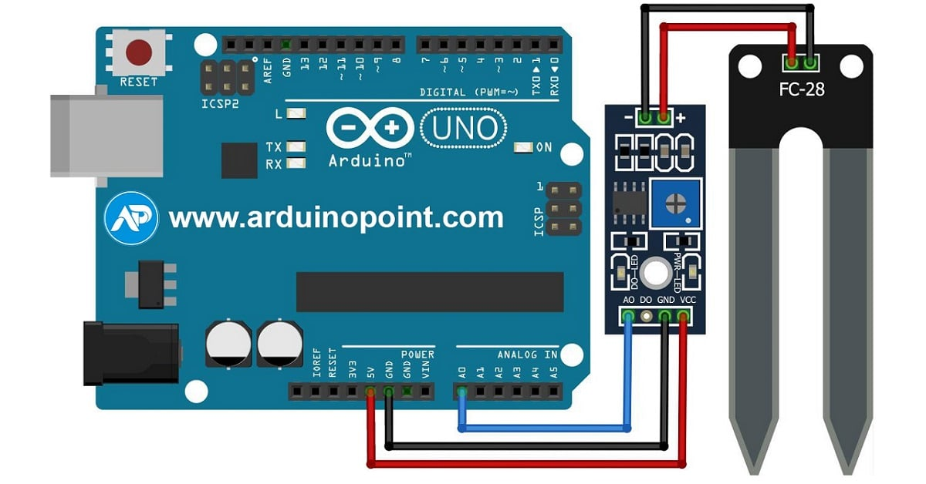
Soil moisture

Slide 26
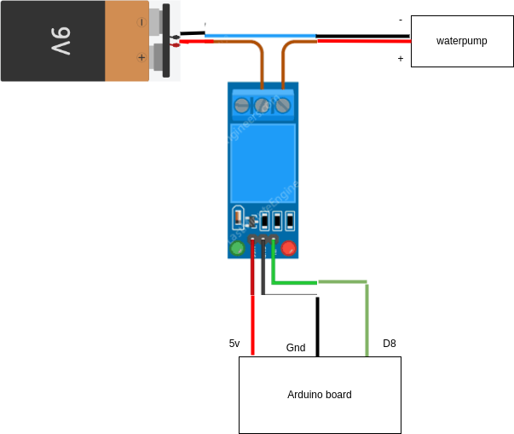
motor & relay

Slide 27
Why do we need a relay ? couldn’t we just connect the motor directly to the arduino
Arduino cannot supply the motor with 5v of voltage
a motor would need 9v inorder to work
this is where the relay comes in
it will play the role of a barrage of a 9v power supply (battery)
the portal of the barrage is opened and closed by the arduino

Slide 28
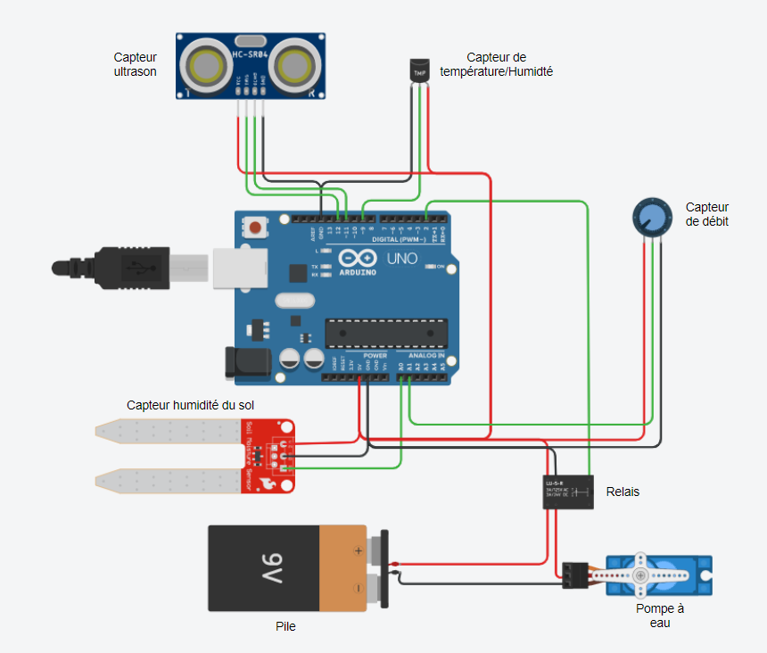
General schema of the project

Slide 29
Creating a project in arduino cloud

Slide 30
Creating a project in arduino cloud
Arduino cloud is the website that will allow us to visualize changes in our data in real time
You can think of a cloud as if it was a set of computers that will communicate with your arduino
it has a space to code our program
it has predefined libraries that are predefined (such as DH11 library)
it has a graphical user interface to simplify the work instead of programming everything manually

Slide 31
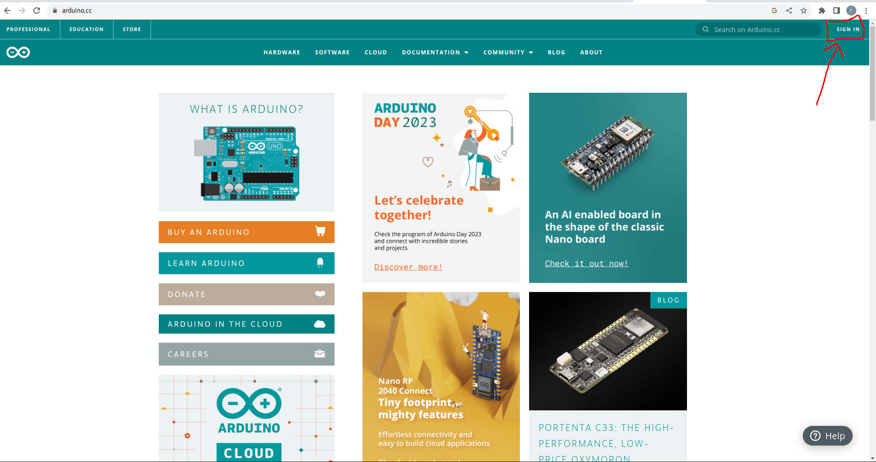
Creating a project in arduino cloud
go to the official arduino website via this link and sign in
https://www.arduino.cc/

Slide 32
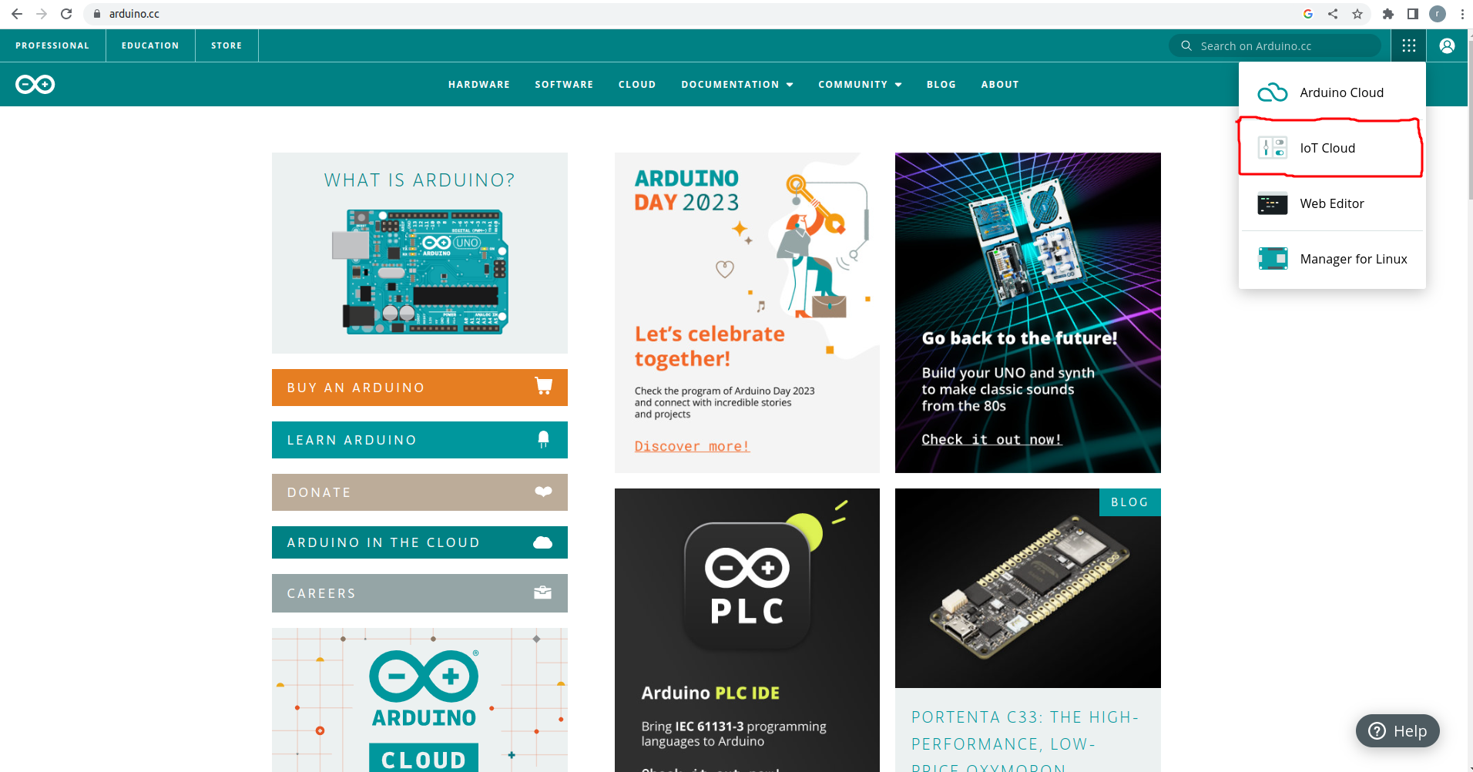
Creating a project in arduino cloud
go to the section : iot cloud

Slide 33
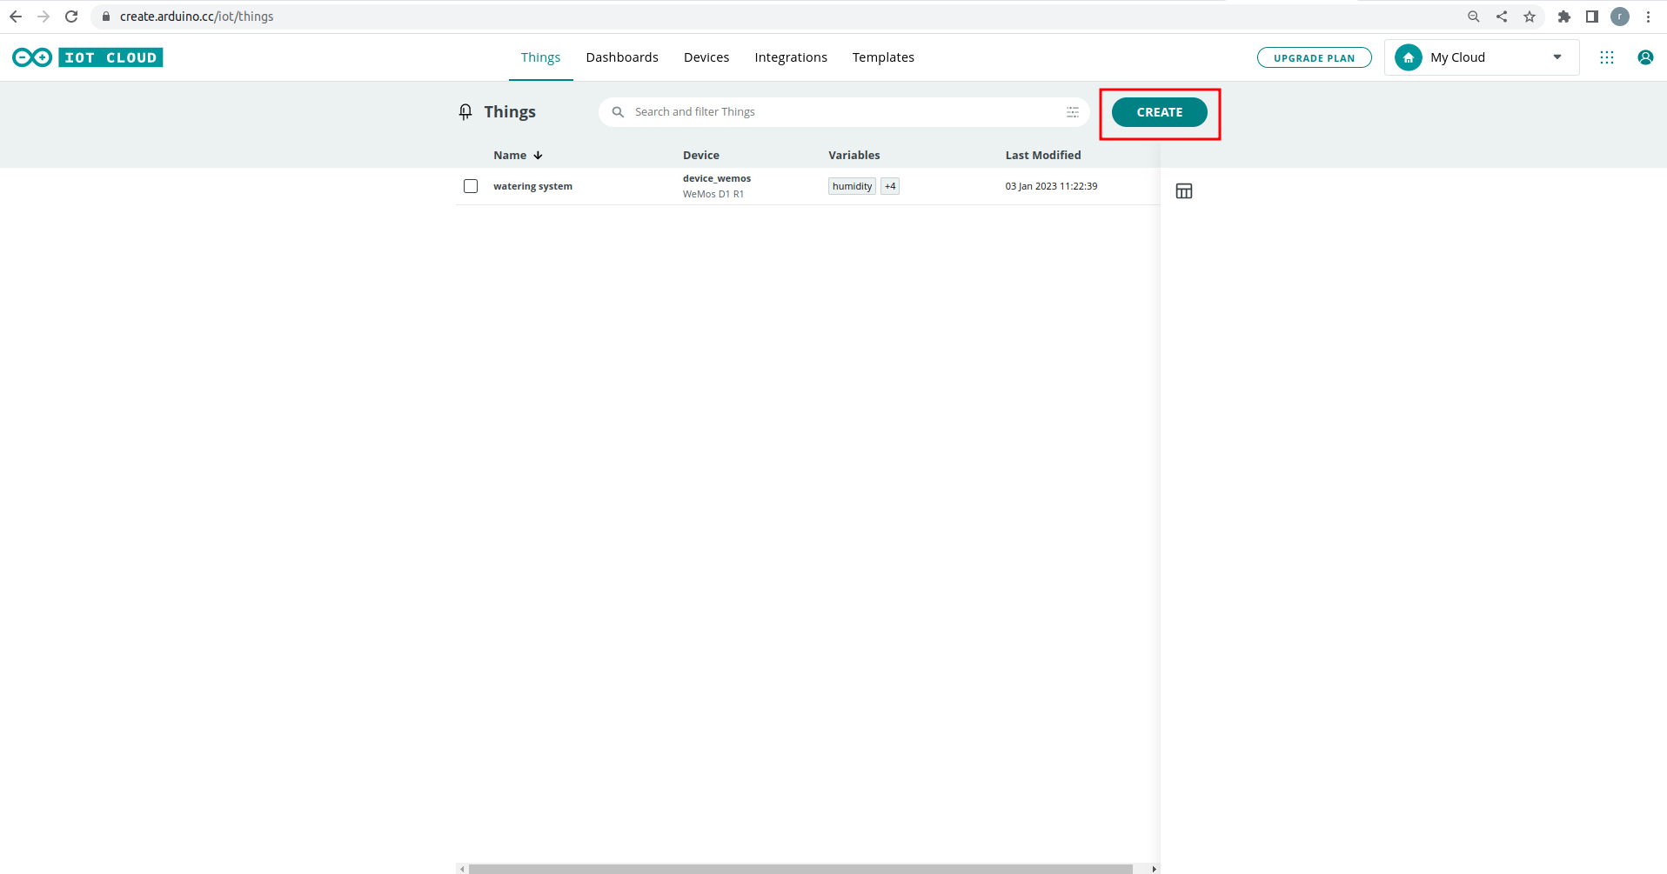
Creating a project in arduino cloud

Slide 34
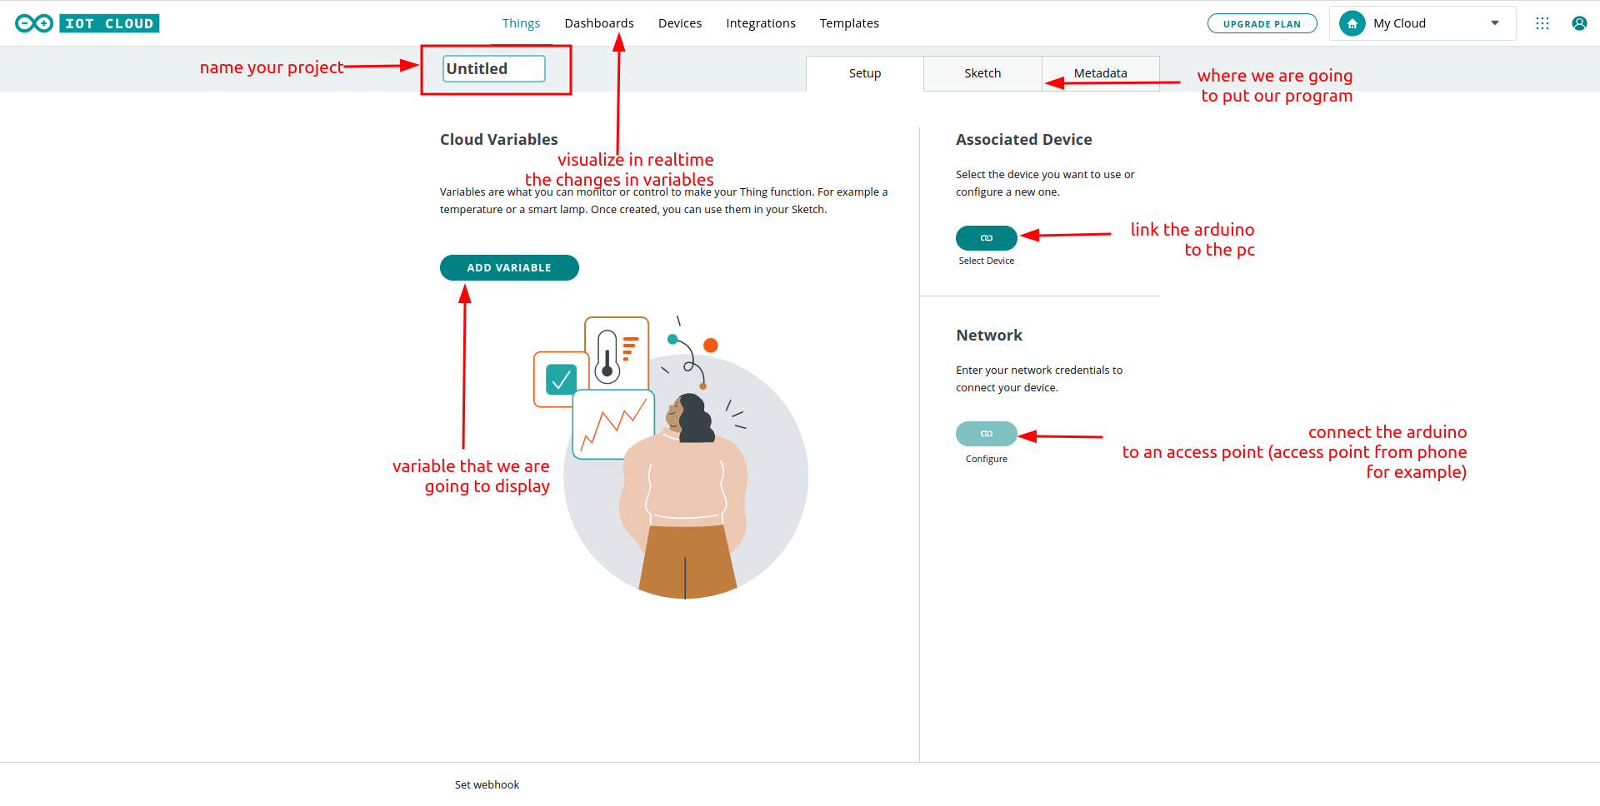
Creating a project in arduino cloud

Slide 35
Adding variables

Slide 36
Adding variables
variables are the data which are in change and will affect on our system
In this project we will be using 4 main variables (to track visualize):
temperature
humidity
soil moisture
water level (for the simplification sake of the project we will actually display how far is the water from the sensor)

Slide 37
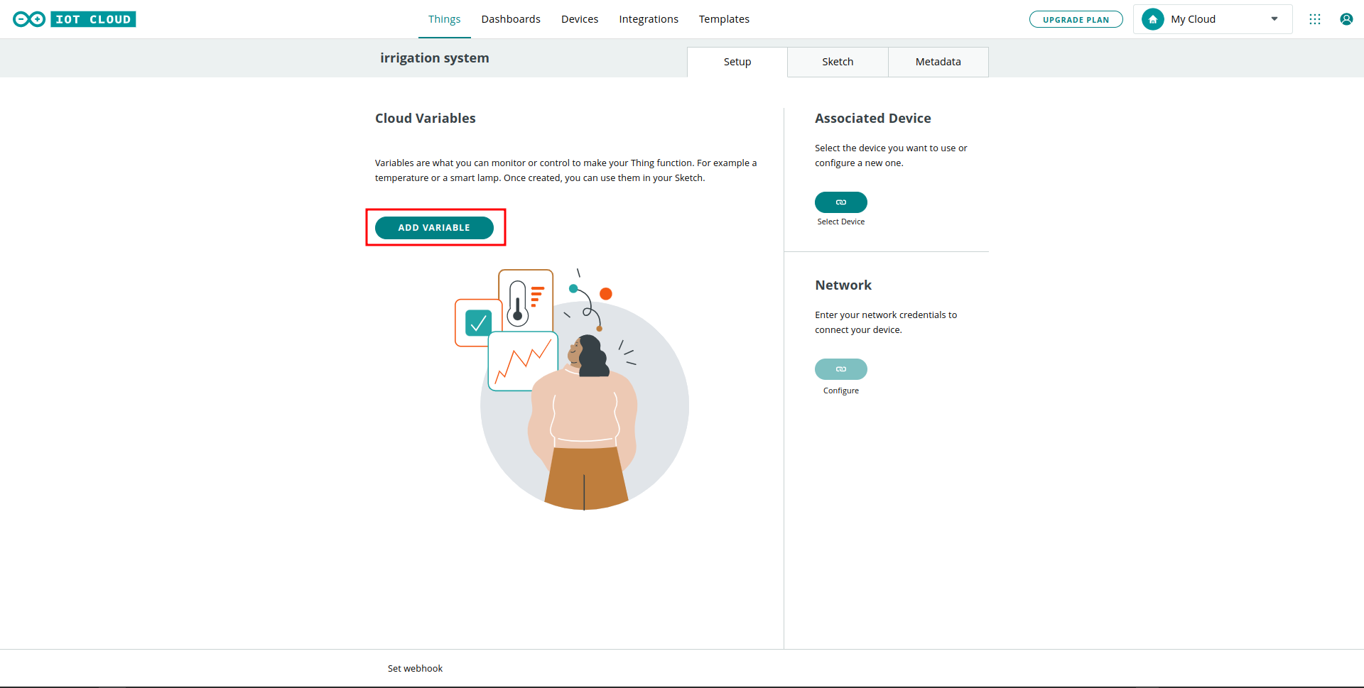
Adding variables

Slide 38
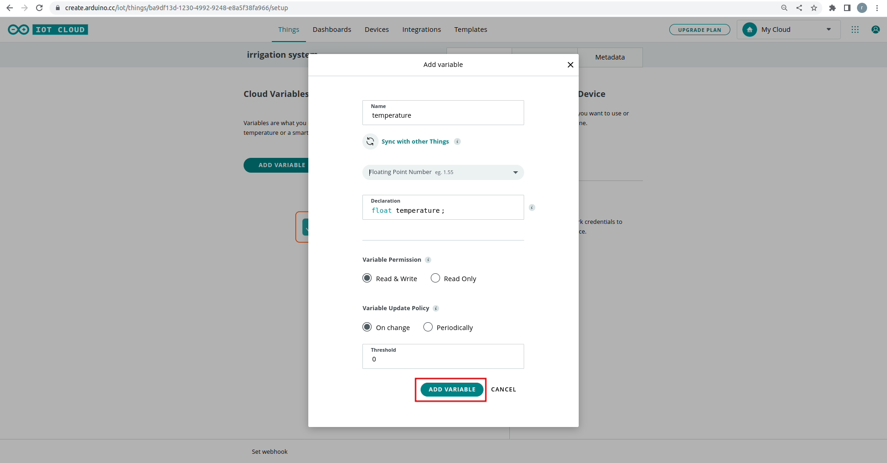
Adding variables

Slide 39
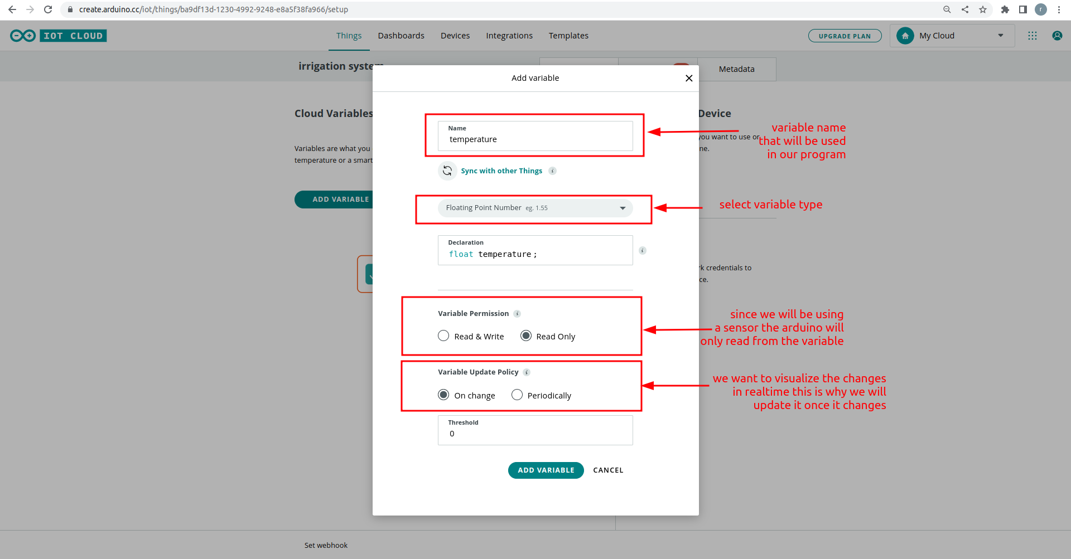
Adding variables

Slide 40
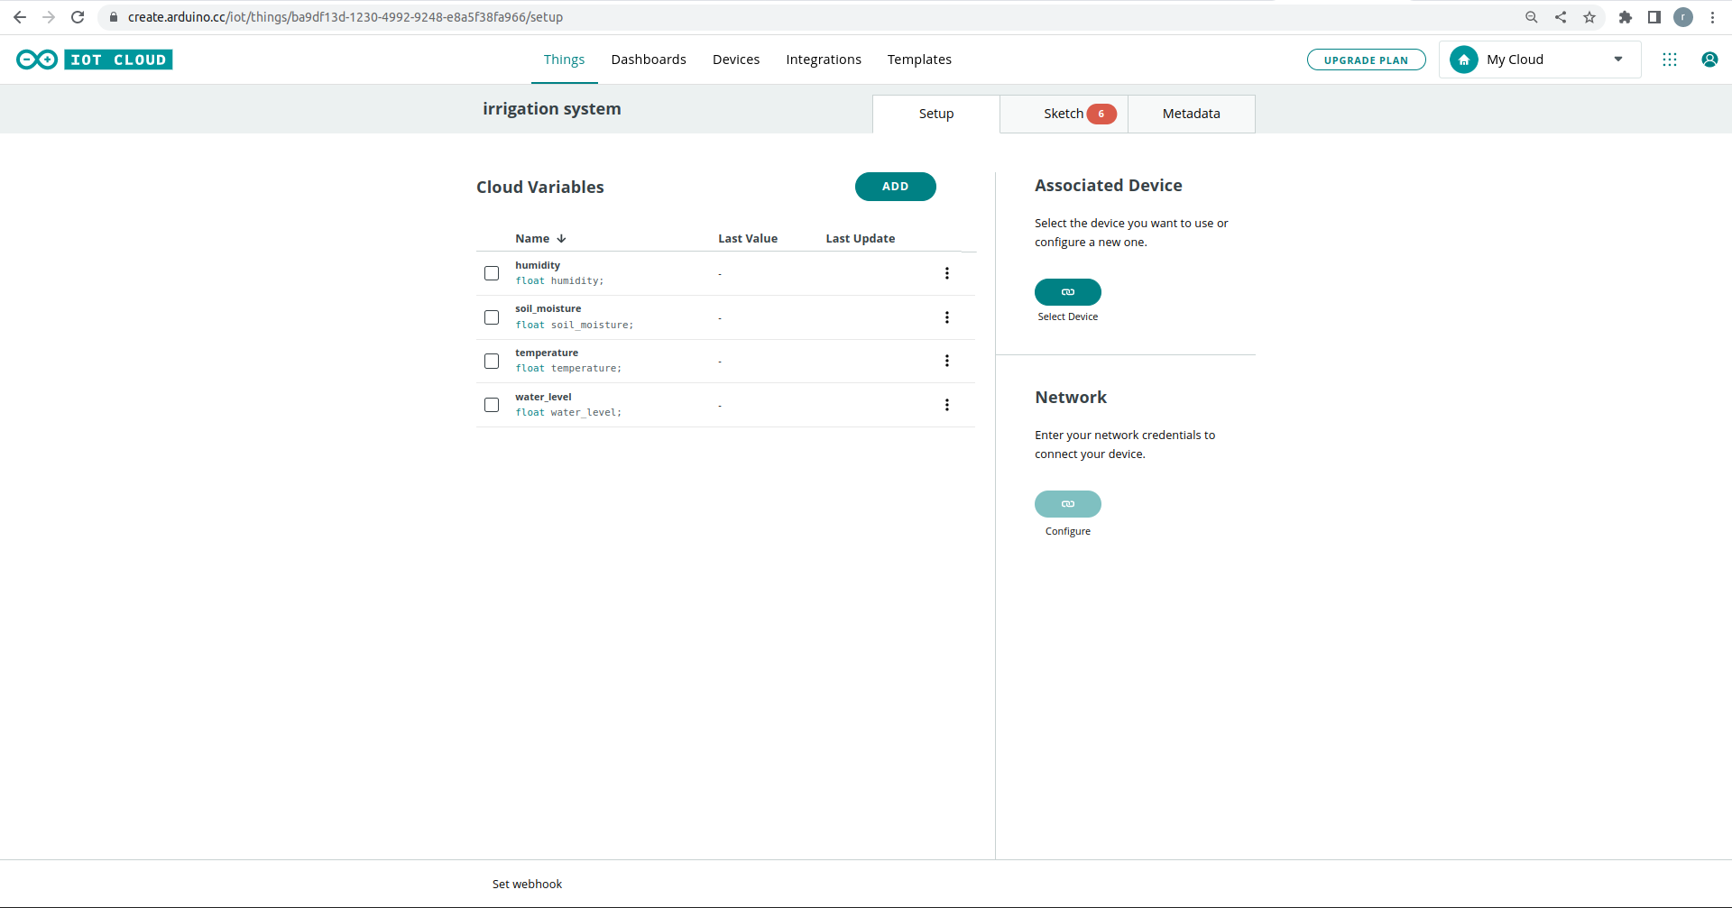
Adding variables
after adding variables :

Slide 41
Associate the arduino with the project

Slide 42
Associate the arduino with the project
Now it is time to let our arduino know the arduino cloud so that they can communicate with each other
we are going to be doing that by giving our arduino a name, and a secret key
a secret key is a security feature that allows a secure connection between the arduino board and arduino cloud

Slide 43
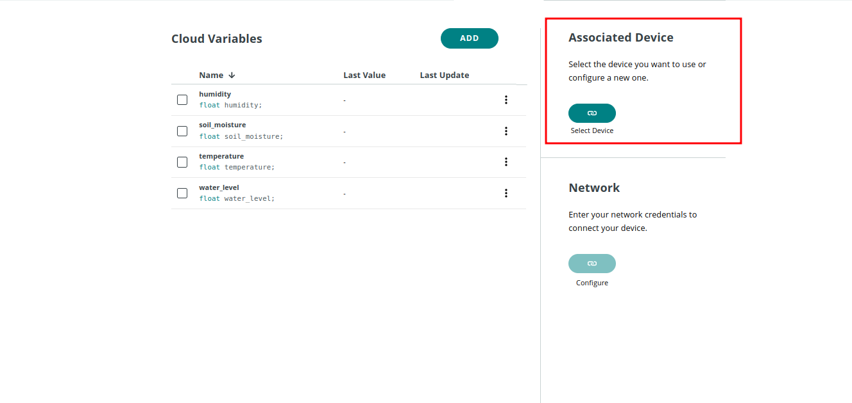
Associate the arduino with the Arduino cloud

Slide 44
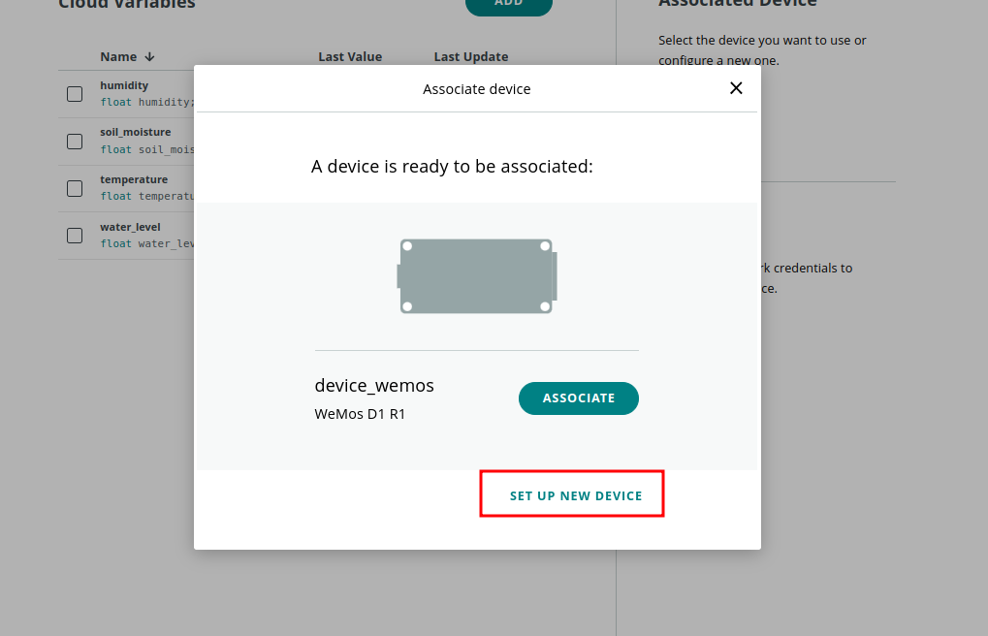
Associate the arduino with the Arduino cloud

Slide 45
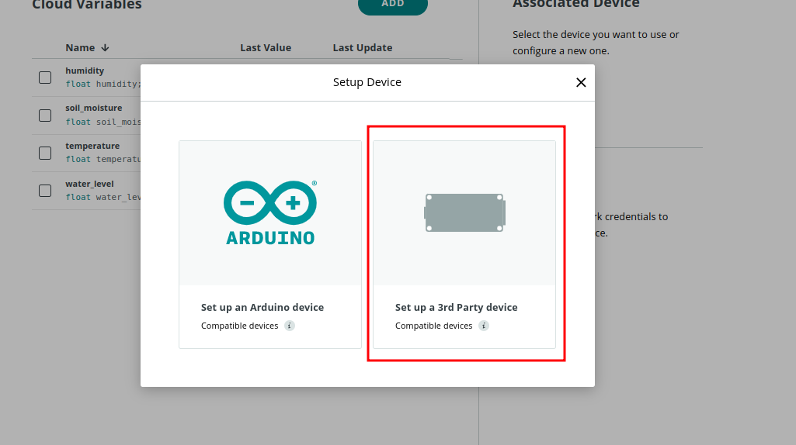
Associate the arduino with the Arduino cloud

Slide 46
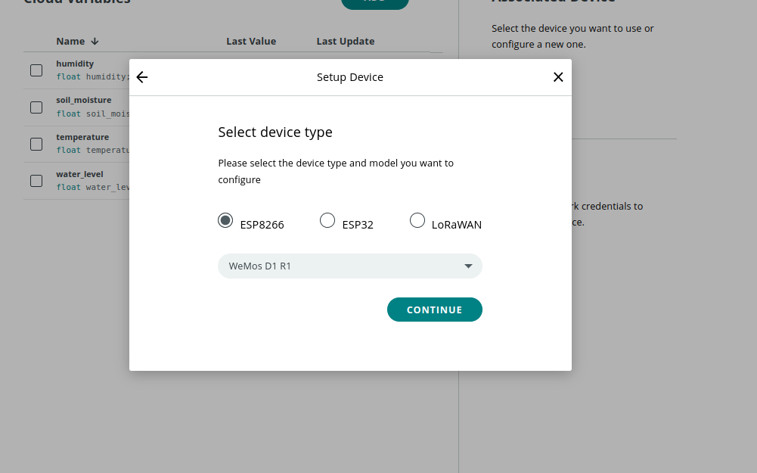
Associate the arduino with the Arduino cloud

Slide 47
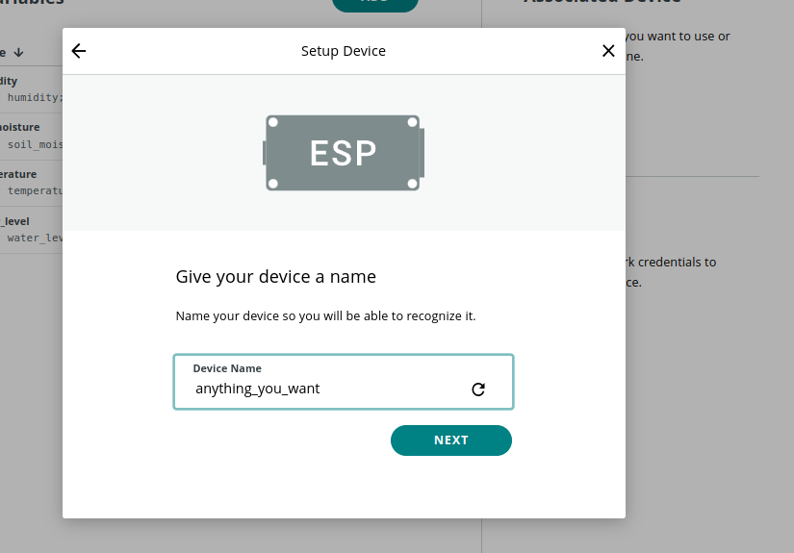
Associate the arduino with the Arduino cloud

Slide 48
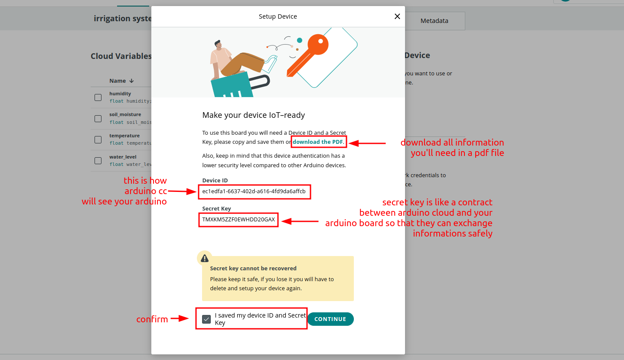
Associate the arduino with the Arduino cloud

Slide 49
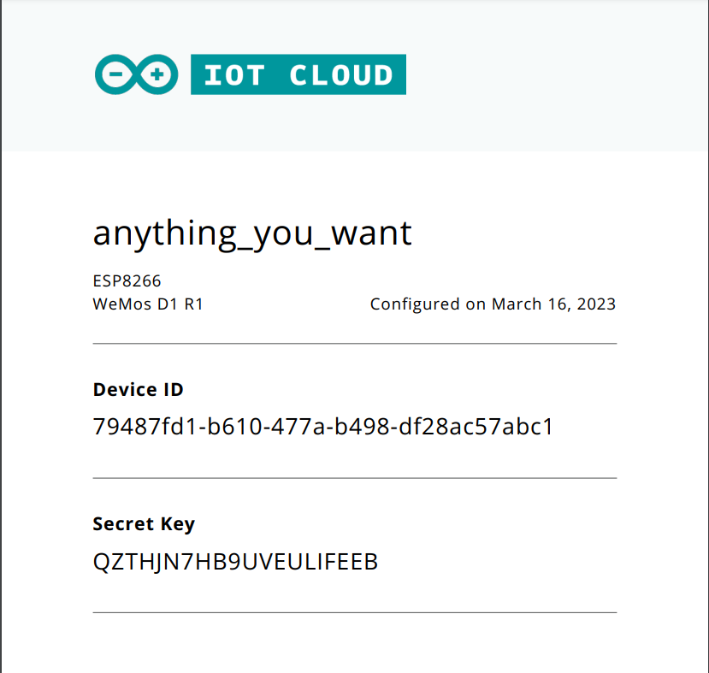
Associate the arduino with the Arduino cloud

Slide 50
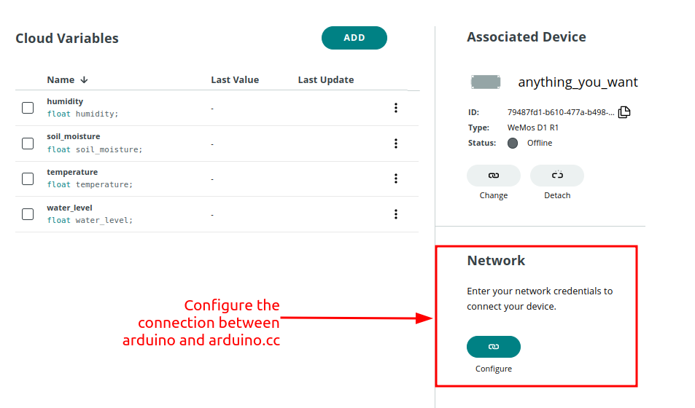
Associate the arduino with the Arduino cloud

Slide 51
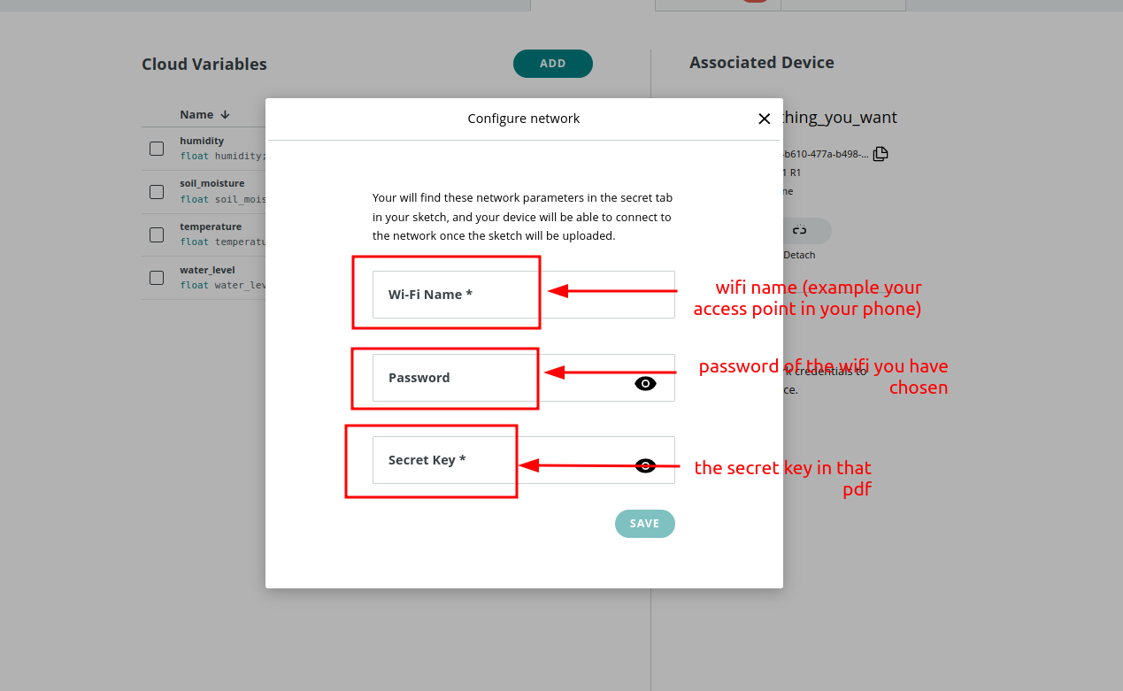
Associate the arduino with the Arduino cloud

Slide 52
Moving to the code …

Slide 53
Moving to the code
The code is available on github (link provided later) the next section is for explanation purposes
the data is collected from environment using sensors and they are interpreted from arduino as specific values (analog [0-1023] or digital [0-1]) this is why you are going some lines of code when we transform the code from values that arduino understand to human readable values

Slide 54
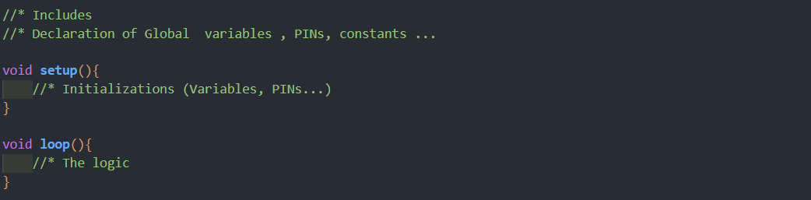
General structure of an Arduino program

Slide 55
Data collection

Slide 56
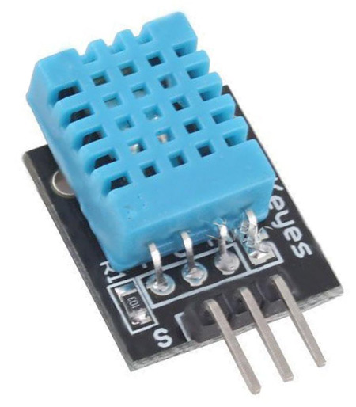
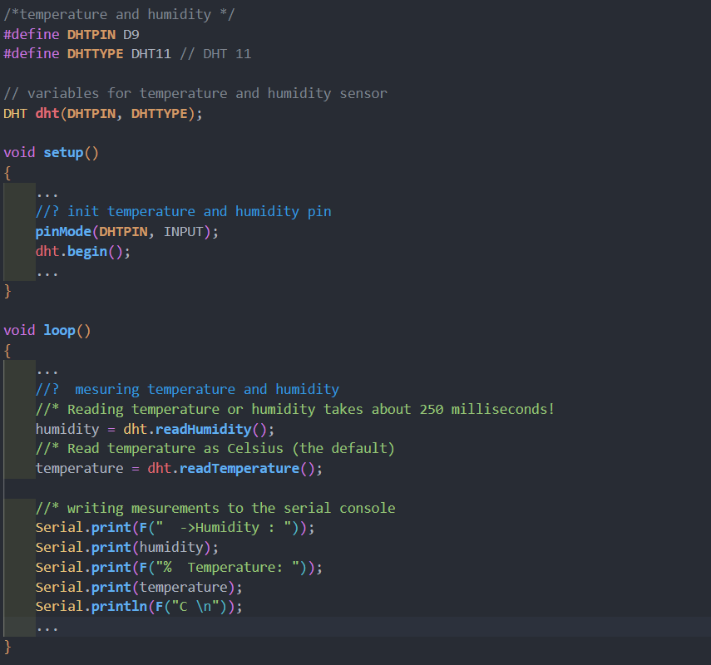
Temperature and Humidity sensor

Slide 57
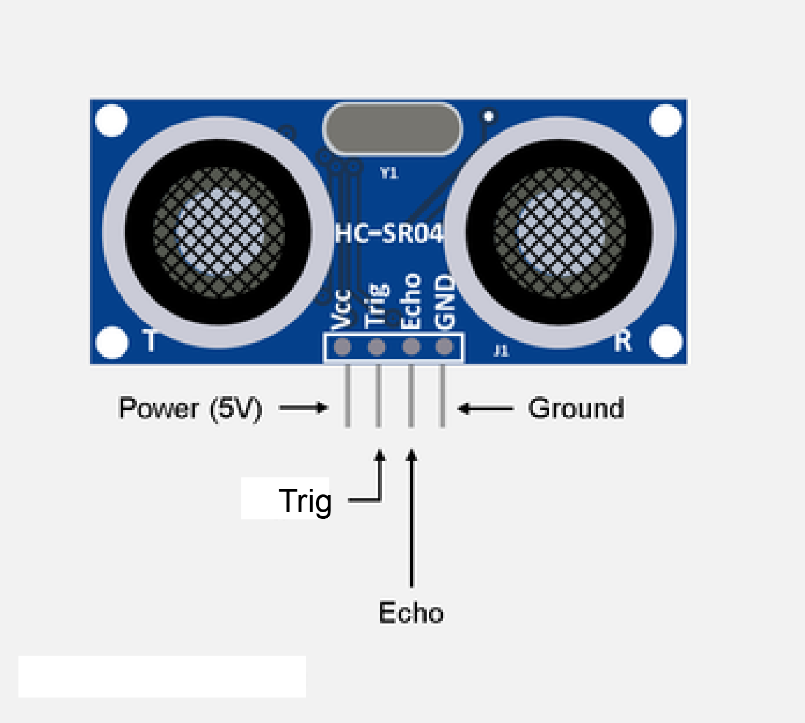
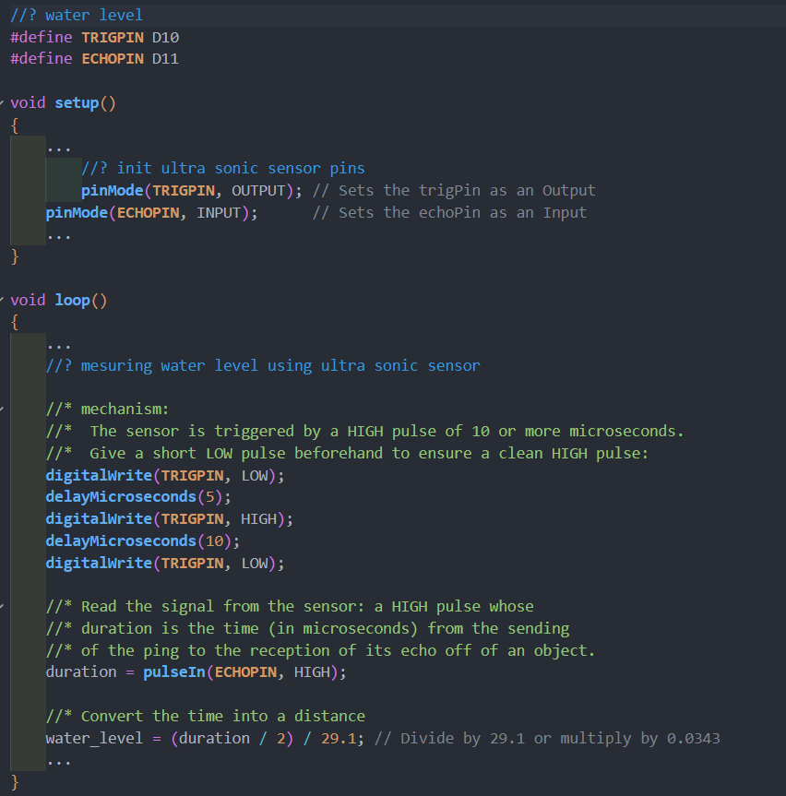
Ultrasonic sensor

Slide 58

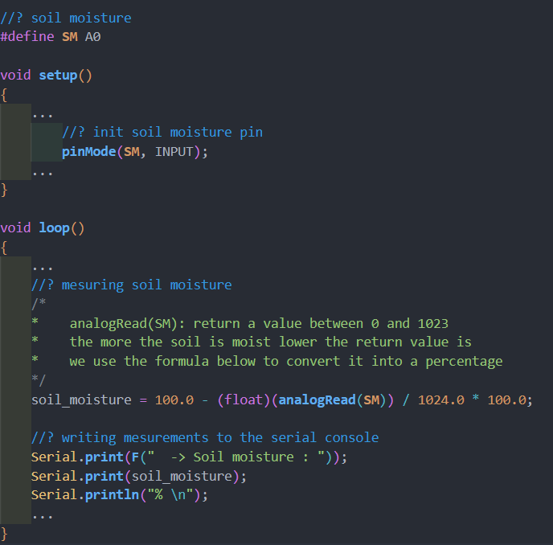
Soil moisture sensor

Slide 59
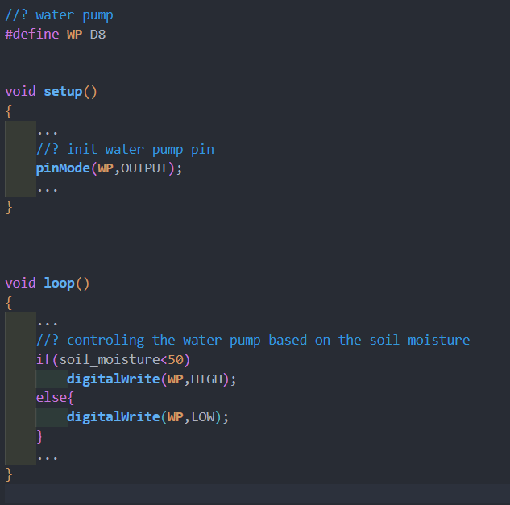
Water pump sensor

Slide 60
Sending data to google sheet

Slide 61
connect the arduino to ifttt server

Slide 62
connect the arduino to ifttt server
As we mentioned earlier we will be using ifttt server as intermediate between arduino and the google sheet, it will help us to visualize data in real time (from the cloud)
we are going to give the identity of our arduino to ifttt server and make them connect with each other so that ifttt server takes the data from your arduino board and write it in google sheet
the way it works is simple : if a change occurs in one of the variables arduino will send a signal to the ifttt and this one will be sending this to google sheet
there is a part in the final code where a function (send_data_to_sheet()) is executed this is the part where arduino will send it to ifttt and ifttt will handle the rest

Slide 63
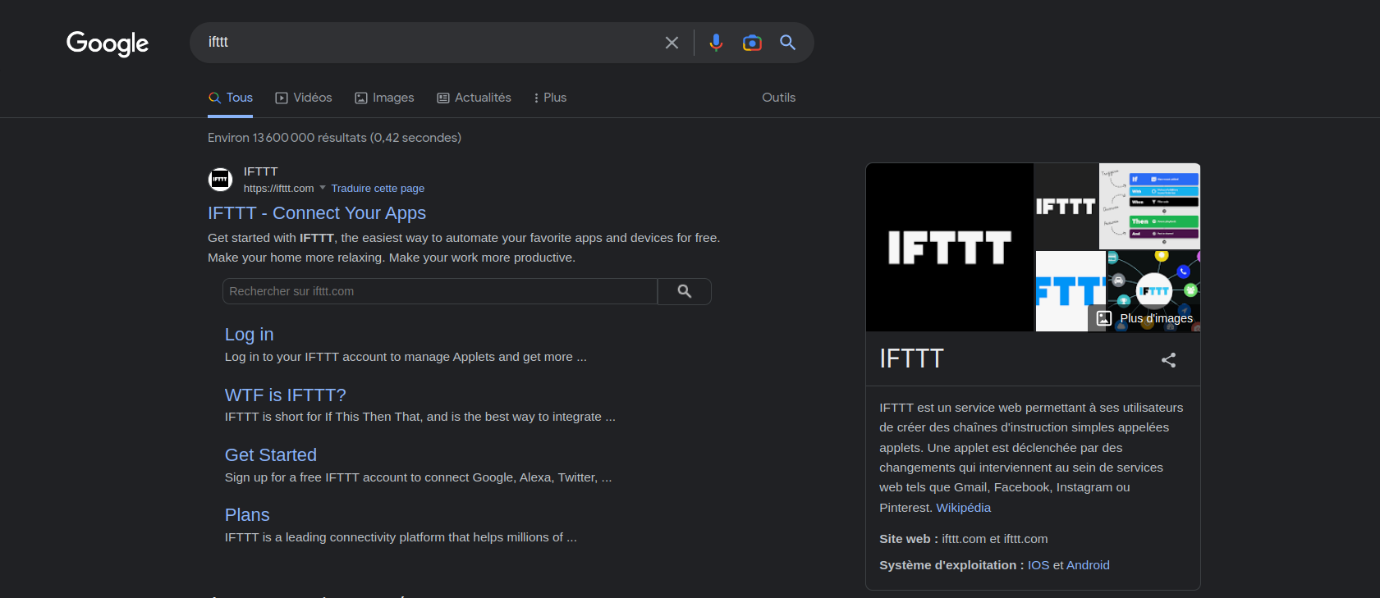
connect the arduino to ifttt server

Slide 64
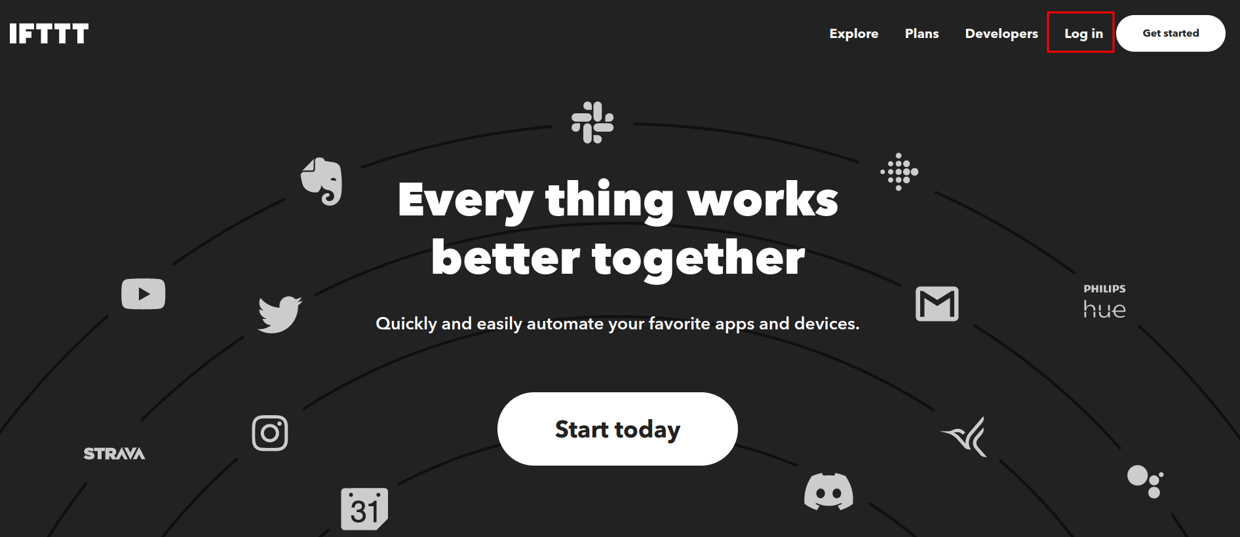
connect the arduino to ifttt server

Slide 65
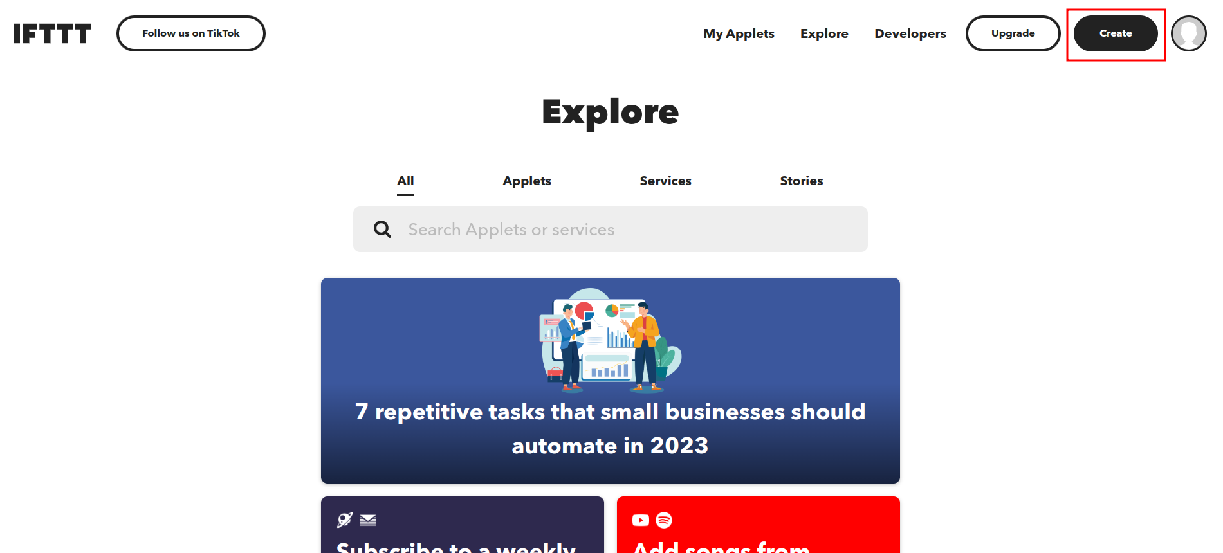
connect the arduino to ifttt server

Slide 66
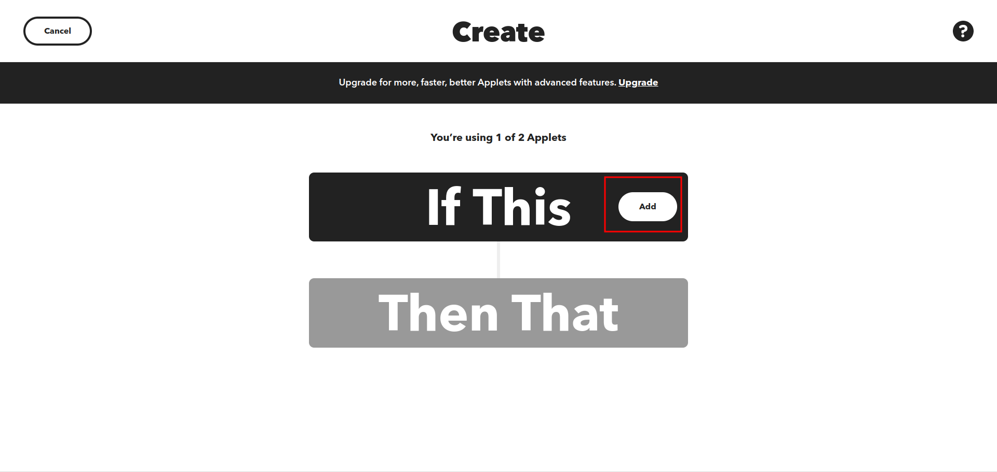
connect the arduino to ifttt server

Slide 67
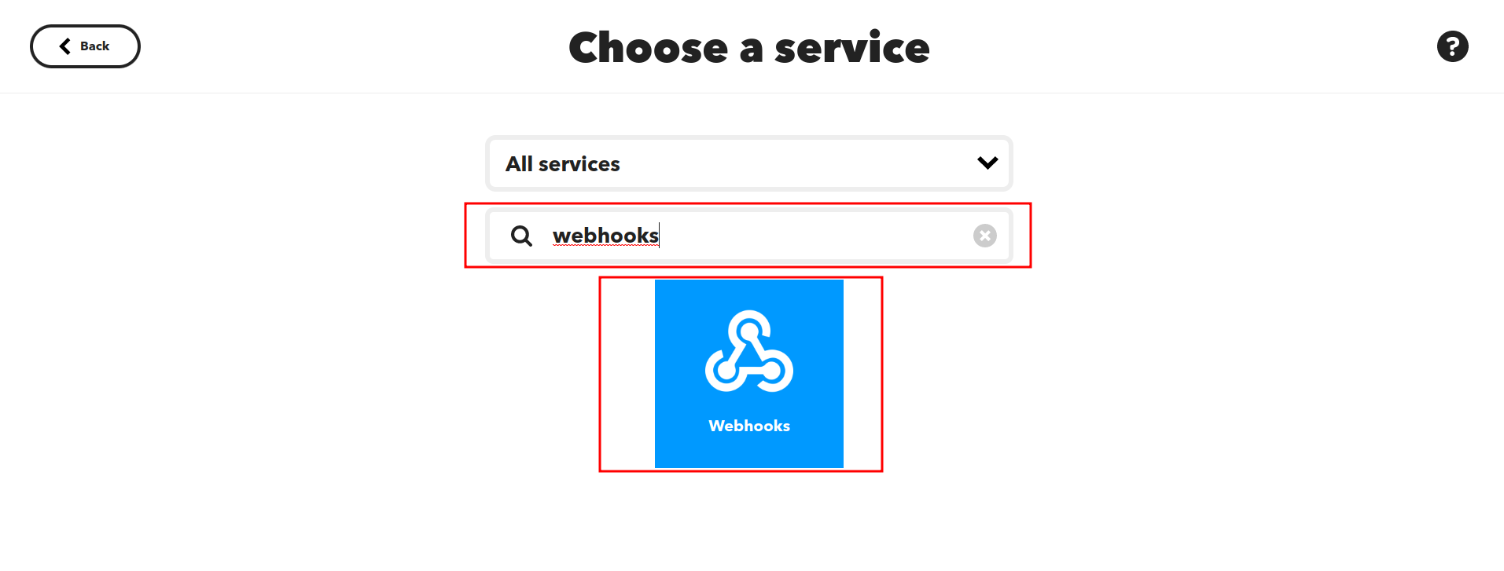
connect the arduino to ifttt server

Slide 68
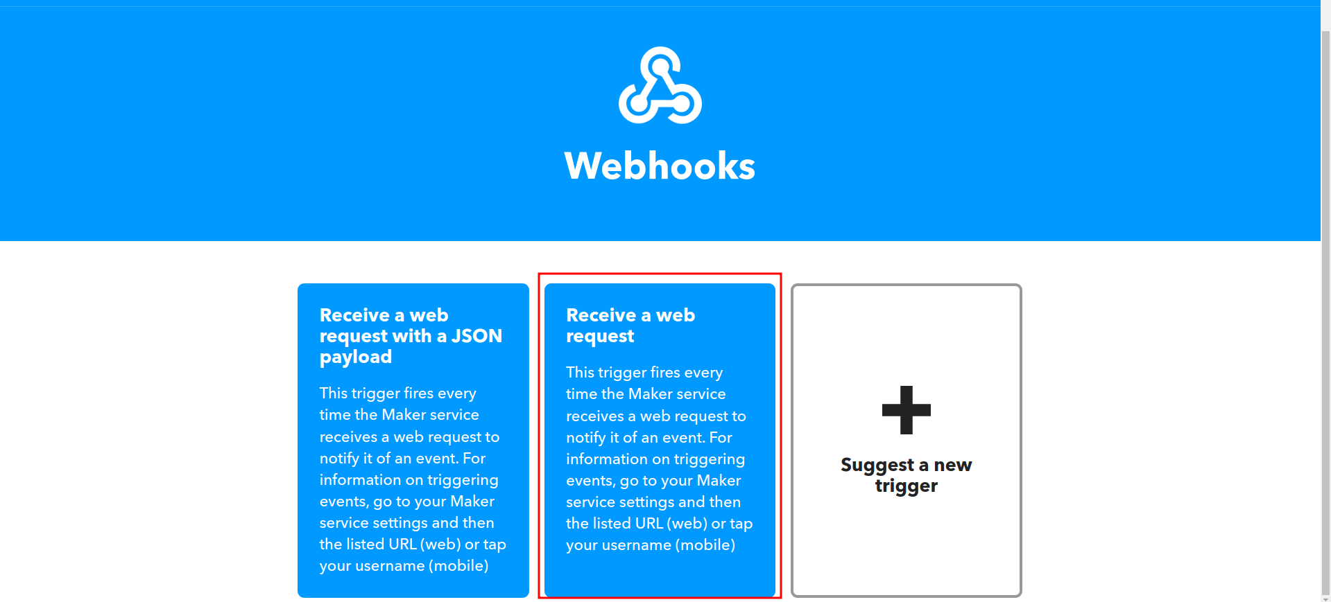
connect the arduino to ifttt server

Slide 69

connect the arduino to ifttt server

Slide 70

connect the arduino to ifttt server

Slide 71

connect the arduino to ifttt server

Slide 72

connect the arduino to ifttt server

Slide 73

connect the arduino to ifttt server

Slide 74

connect the arduino to ifttt server

Slide 75

connect the arduino to ifttt server

Slide 76

connect the arduino to ifttt server

Slide 77

connect the arduino to ifttt server

Slide 78

connect the arduino to ifttt server

Slide 79

connect the arduino to ifttt server

Slide 80

connect the arduino to ifttt server

Slide 81

connect the arduino to ifttt server

Slide 82

connect the arduino to ifttt server

Slide 83

connect the arduino to ifttt server

Slide 84

connect the arduino to ifttt server

Slide 85

connect the arduino to ifttt server

Slide 86

connect the arduino to ifttt server

Slide 87
visualizing results in realtime

Slide 88
visualizing results in realtime
This is the part where you can see the actual changes graphically on Arduino cloud
you can download the mobile version of Arduino cloud and log in from your account so that you can visualize those changes in from your phone

Slide 89

visualizing results in realtime

Slide 90

visualizing results in realtime

Slide 91

visualizing results in realtime

Slide 92

visualizing results in realtime

Slide 93

visualizing results in realtime

Slide 94

visualizing results in realtime

Slide 95

visualizing results in realtime

Slide 96

visualizing results in realtime

Slide 97

visualizing results in realtime

Slide 98

visualizing results in realtime

Slide 99
Putting the code in the sketch

Slide 100
Putting the code in the sketch
https://github.com/Rayane-Aboud/Irrigation_system/blob/main/code/code.ino
copy the code over there and paste it in the sketch section

Slide 101

Putting the code in the sketch

Slide 102
Putting the code in the sketch
Connect the arduino to your pc and run the program
if the arduino is not detected follow the instructions in this link :
https://support.arduino.cc/hc/en-us/articles/360014869820-Install-the-Arduino-Create-Agent

Slide 103
References
Integrating IFTTT to arduino cloud:
https://www.youtube.com/watch?v=YkA4TUgCmRA&t=1s
https://www.youtube.com/watch?v=teY9xfSBxE4
DHT sensor tutorial :
https://tutoduino.fr/debuter/capteur-temperature/
UltraSonic sensor tutorial :
https://howtomechatronics.com/tutorials/arduino/ultrasonic-sensor-hc-sr04/
Soil moisture sensor:
https://circuitdigest.com/microcontroller-projects/interfacing-soil-moisture-sensor-with-arduino-uno
Relay configuration:
https://arduinogetstarted.com/tutorials/arduino-relay

